Slide 1
Java PPT
PPT on Servlet

Slide 2
Servlet PPT
Servlet technology is used to create web application (resides at server side and generates dynamic web page).
Servlet technology is robust and scalable because of java language. Before Servlet, CGI (Common Gateway Interface) scripting language was popular as a server-side programming language. But there was many disadvantages of this technology. We have discussed these disadvantages below.

Slide 3
Servlet PPT
What is Servlet?
Servlet is a technology i.e. used to create web application.
Servlet is an API that provides many interfaces and classes including documentations.
Servlet is an interface that must be implemented for creating any servlet.
Servlet is a class that extend the capabilities of the servers and respond to the incoming request. It can respond to any type of requests.
Servlet is a web component that is deployed on the server to create dynamic web page.

Slide 4
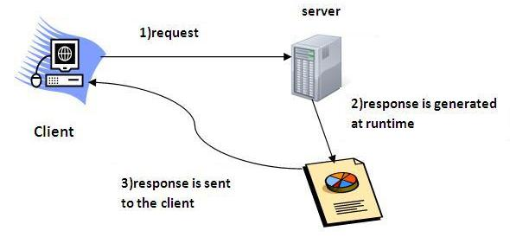
Servlet PPT

Slide 5
Servlet PPT
What is Web Application?
A web application is an application accessible from the web. A web application is composed of web components like Servlet, JSP, Filter etc. and other components such as HTML. The web components typically execute in Web Server and respond to HTTP request.

Slide 6
Servlet PPT
Common Gateway Interface (CGI) :-
CGI technology enables the web server to call an external program and pass HTTP request information to the external program to process the request. For each request, it starts a new process.

Slide 7
Servlet PPT
Disadvantages of CGI :-
There are many problems in CGI technology:
If number of clients increases, it takes more time for sending response.
For each request, it starts a process and Web server is limited to start processes.
It uses platform dependent language e.g. C, C++, perl.

Slide 8
Servlet PPT
Advantages of CGI :-
The basic advantages of a Servlet is as follows:
better performance: because it creates a thread for each request not process.
Portability: because it uses java language.
Robust: Servlets are managed by JVM so we don't need to worry about memory leak, garbage collection etc.
Secure: because it uses java language..

Slide 9
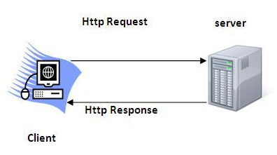
Servlet PPT
Hyper Text Transfer Protocol (HTTP) :-
The Hypertext Transfer Protocol (HTTP) is application-level protocol for collaborative, distributed, hypermedia information systems. It is the data communication protocol used to establish communication between client and server.

Slide 10
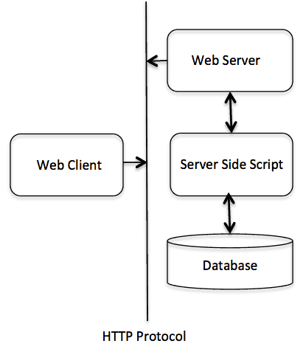
Servlet PPT
Basic Architecture of HTTP(Hyper Text Transfer Protocol):-

Slide 11
Servlet PPT
HTTP Request:-The request sends by the computer to a web server that contains all sorts of potentially interesting information is known as HTTP requests.
The HTTP client sends the request to the server in the form of request message which includes following information:
The Request-line
The analysis of source IP address, proxy and port
The analysis of destination IP address, protocol, port and host
The Requested URI (Uniform Resource Identifier)
The Request method and Content
The User-Agent header
The Connection control header
The Cache control header

Slide 12
Servlet PPT
The HTTP Request are as follows:
HTTP Request | Description
GET | Asks to get the resource at the requested URL.
POST | Asks the server to accept the body info attached. It is like GET request with extra info sent with the request.
HEAD | Asks for only the header part of whatever a GET would return. Just like GET but with no body.
TRACE | Asks for the loopback of the request message, for testing or troubleshooting.
PUT | Says to put the enclosed info (the body) at the requested URL.
DELETE | Says to delete the resource at the requested URL.
OPTION | Asks for a list of the HTTP methods to which the thing at the request URL can respond

Slide 13
Servlet PPT
GET and POST Request:-
GET Request:- In case of Get request, only limited amount of data can be sent because data is sent in header.
Get request is not secured because data is exposed in URL bar.
Get request can be bookmarked.
Get request is idempotent . It means second request will be ignored until response of first request is delivered
Get request is more efficient and used more than Post.

Slide 14
Servlet PPT
GET and POST Request:-
POST Request:- In case of Get request, only limited amount of data can be sent because data is sent in header.
Get request is not secured because data is exposed in URL bar.
Get request can be bookmarked.
Get request is idempotent . It means second request will be ignored until response of first request is delivered
Get request is more efficient and used more than Post.

Slide 15
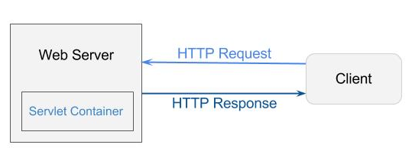
Servlet PPT
Servlet Container:- It provides the runtime environment for JavaEE (j2ee) applications. The client/user can request only a static WebPages from the server. If the user wants to read the web pages as per input then the servlet container is used in java.
The servlet container is used in java for dynamically generate the web pages on the server side. Therefore the servlet container is the part of a web server that interacts with the servlet for handling the dynamic web pages from the client.

Slide 16
Servlet PPT
Servlet Container States:- The States of the Servlet Container are as follows:
Standalone: It is typical Java-based servers in which the servlet container and the web servers are the integral part of a single program. For example:- Tomcat running by itself
In-process: It is separated from the web server, because a different program is runs within the address space of the main server as a plug-in. For example:- Tomcat running inside the JBoss.
Out-of-process: The web server and servlet container are different programs which are run in a different process. For performing the communications between them, web server uses the plug-in provided by the servlet container.

Slide 17
Servlet PPT
Servlet Container States:- The Servlet Container may perform the following action:
Life Cycle Management
Multithreaded support
Object Pooling
Security etc.

Slide 18
Servlet PPT
Server: Web Vs Application:-
Server is a device or a computer program that accepts and responds to the request made by other program, known as client. It is used to manage the network resources and for running the program or software that provides services.
There are two types of servers:
Web Server
Application Server

Slide 19
Servlet PPT
Server: Web Server:-
Web server contains only web or servlet container. It can be used for servlet, jsp, struts, jsf etc. It can't be used for EJB.
It is a computer where the web content can be stored. In general web server can be used to host the web sites but there also used some other web servers also such as FTP, email, storage, gaming etc.
Examples of Web Servers are: Apache Tomcat and Resin.

Slide 20
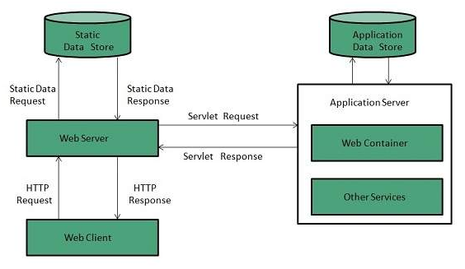
Servlet PPT
Server: Web Server Working Procedure:-

Slide 21
Servlet PPT
Server: Application Server:-
Application server contains Web and EJB containers. It can be used for servlet, jsp, struts, jsf, ejb etc. It is a component based product that lies in the middle-tier of a server centric architecture.
It provides the middleware services for state maintenance and security, along with persistence and data access. It is a type of server designed to install, operate and host associated services and applications for the IT services, end users and organizations.
E.g. of Application Server:-
JBoss: Open-source server from JBoss community.
Glassfish: Provided by Sun Microsystem. Now acquired by Oracle.
Weblogic: Provided by Oracle. It more secured.
Websphere: Provided by IBM.

Slide 22
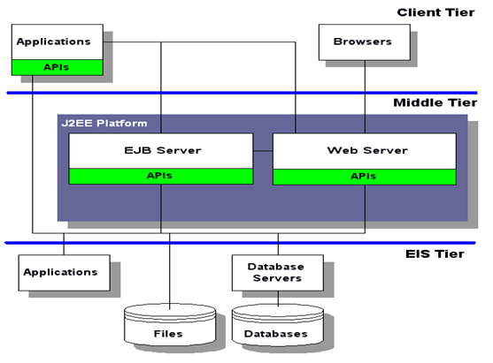
Servlet PPT
Server: Application Server Working Procedure:-

Slide 23
Servlet PPT
Lifecycle of a Servlet:-
The web container maintains the life cycle of a servlet instance. Let's see the life cycle of the servlet:
Servlet class is loaded.
Servlet instance is created.
init method is invoked.
service method is invoked.
destroy method is invoked.

Slide 24
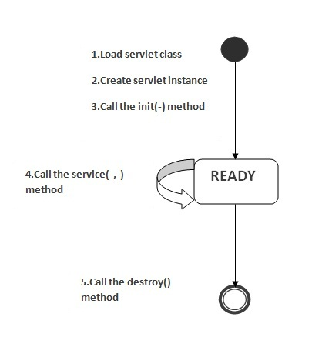
Servlet PPT
Lifecycle of a Servlet:-

Slide 25
Servlet PPT
Steps to create a Servlet:-
We are going to use apache tomcat server in this example. The steps are as follows:
Create a directory structure
Create a Servlet
Compile the Servlet
Create a deployment descriptor
Start the server and deploy the project
Access the servlet

Slide 26
Servlet PPT
How Web Container handles the Servlet Request:-
The web container is responsible to handle the request. Let's see how it handles the request.
maps the request with the servlet in the web.xml file.
creates request and response objects for this request
calls the service method on the thread
The public service method internally calls the protected service method
The protected service method calls the doGet method depending on the type of request.
The doGet method generates the response and it is passed to the client.
After sending the response, the web container deletes the request and response objects. The thread is contained in the thread pool or deleted depends on the server implementation.

Slide 27
Servlet PPT
How Web Container handles the Servlet Request:-
The web container is responsible to handle the request. Let's see how it handles the request.
maps the request with the servlet in the web.xml file.
creates request and response objects for this request
calls the service method on the thread
The public service method internally calls the protected service method
The protected service method calls the doGet method depending on the type of request.
The doGet method generates the response and it is passed to the client.
After sending the response, the web container deletes the request and response objects. The thread is contained in the thread pool or deleted depends on the server implementation.

Slide 28
Servlet PPT
WAR File in Servlet:-
A war (web archive) File contains files of a web project. It may have servlet, xml, jsp, image, html, css, js etc. files.
web archive (war) file contains all the contents of a web application. It reduces the time duration for transferring file.
Advantage of war file:-
saves time: The war file combines all the files into a single unit. So it takes less time while transferring file from client to server.

Slide 29
Servlet PPT
WAR File in Servlet:-
Create WAR File:-
To create war file, you need to use jar tool of JDK. You need to use -c switch of jar, to create the war file.
Go inside the project directory of your project (outside the WEB-INF), then write the following command:
jar -cvf projectname.war *
Here, -c is used to create file, -v to generate the verbose output and -f to specify the arhive file name.
The * (asterisk) symbol signifies that all the files of this directory (including sub directory).

Slide 30
Servlet PPT
WAR File in Servlet:-
Deploy WAR File:-
There are two ways to deploy the war file.
By server console panel
By manually having the war file in specific folder of server.
Extract WAR Files Manually:- To extract the WAR Files manually, we should use
jar -xvf projectname.war

Slide 31
Servlet PPT
Welcome File List in web.xml:-
A welcome file is the file that is invoked automatically by the server, if you don't specify any file name.
By default server looks for the welcome file in following order:
welcome-file-list in web.xml
index.html
index.htm
index.jsp
If none of these files are found, server renders 404 error.

Slide 32
Servlet PPT
Structure of web.xml:-
<web-app>
....
<welcome-file-list>
<welcome-file>home.html</welcome-file>
<welcome-file>default.html</welcome-file>
</welcome-file-list>
</web-app>
Now, home.html and default.html will be the welcome files.
If you have the welcome file, you can directory invoke the project as given below:
http://localhost:8888/myproject

Slide 33
Servlet PPT
load on startup in web.xml:-
The load-on-startup element of web-app loads the servlet at the time of deployment or server start if value is positive. It is also known as pre initialization of servlet.
Advantage of load-on-startup element:-
As you know well, servlet is loaded at first request. That means it consumes more time at first request. If you specify the load-on-startup in web.xml, servlet will be loaded at project deployment time or server start. So, it will take less time for responding to first request.

Slide 34
Servlet PPT
<web-app>
....
<servlet>
<servlet-name>servlet1</servlet-name>
<servlet-class>com.javatpoint.FirstServlet</servlet-class>
<load-on-startup>0</load-on-startup>
</servlet>
<servlet>
<servlet-name>servlet2</servlet-name>
<servlet-class>com.javatpoint.SecondServlet</servlet-class>
<load-on-startup>1</load-on-startup>
</servlet>
...
</web-app>

Slide 35
Servlet PPT
RequestDispatcher Interface:- An object of ServletRequest is used to provide the client request information to a servlet such as content type, content length, parameter names and values, header informations, attributes etc.
The RequestDispatcher interface provides the facility of dispatching the request to another resource it may be html, servlet or jsp. This interface can also be used to include the content of another resource also. It is one of the way of servlet collaboration.
There are two methods defined in the RequestDispatcher interface.

Slide 36
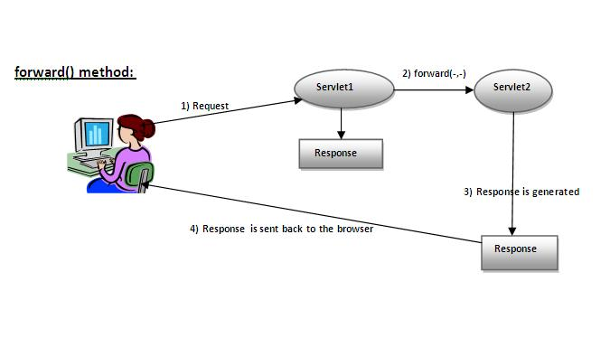
Servlet PPT
RequestDispatcher Interface:- There are two methods defined in the RequestDispatcher interface.
public void forward(ServletRequest request,ServletResponse response)throws ServletException,java.io.IOException:- Forwards a request from a servlet to another resource (servlet, JSP file, or HTML file) on the server.

Slide 37
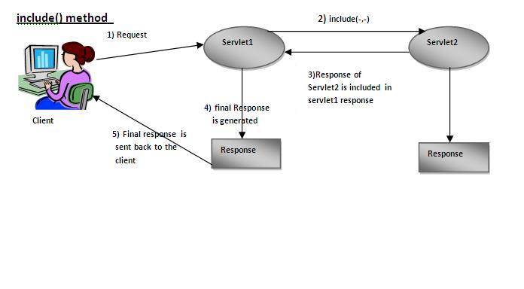
Servlet PPT
RequestDispatcher Interface:- There are two methods defined in the RequestDispatcher interface.
public void include(ServletRequest request,ServletResponse response)throws ServletException,java.io.IOException:- Includes the content of a resource (servlet, JSP page, or HTML file) in the response.

Slide 38
Servlet PPT
SendRedirect Method in Servlet:-
The sendRedirect() method of HttpServletResponse interface can be used to redirect response to another resource, it may be servlet, jsp or html file.
It accepts relative as well as absolute URL.
It works at client side because it uses the url bar of the browser to make another request. So, it can work inside and outside the server.

Slide 39
Servlet PPT
ServletConfig Interface:-
An object of ServletConfig is created by the web container for each servlet. This object can be used to get configuration information from web.xml file.
If the configuration information is modified from the web.xml file, we don't need to change the servlet. So it is easier to manage the web application if any specific content is modified from time to time.
Advantages of ServletConfig Interface:-
The core advantage of ServletConfig is that you don't need to edit the servlet file if information is modified from the web.xml file.

Slide 40
Servlet PPT
Methods of ServletConfig Interface:- There are different methods of ServletConfig Interface. They are as follows:
public String getInitParameter(String name)
public Enumeration getInitParameterNames()
public String getServletName()
public ServletContext getServletContext()

Slide 41
Servlet PPT
ServletContext Interface:- An object of ServletContext is created by the web container at time of deploying the project. This object can be used to get configuration information from web.xml file. There is only one ServletContext object per web application.
If any information is shared to many servlet, it is better to provide it from the web.xml file using the <context-param> element.
Usage of ServletContext Interface:- The usage of ServletContext Interface is described as follows
The object of ServletContext provides an interface between the container and servlet.
The ServletContext object can be used to get configuration information from the web.xml file.
The ServletContext object can be used to set, get or remove attribute from the web.xml file.
The ServletContext object can be used to provide inter-application communication.

Slide 42
Servlet PPT
Attributes in Servlet:- An attribute in servlet is an object that can be set, get or removed from one of the following scopes:
request scope
session scope
application scope
The servlet programmer can pass informations from one servlet to another using attributes. It is just like passing object from one class to another so that we can reuse the same object again and again.

Slide 43
Servlet PPT
Attribute specific methods of ServletRequest, HttpSession and ServletContext interface:-
There are some special attribute specific methods in servlet. They are as follows:
public void setAttribute(String name,Obect object)
public void getAttribute(String name)
public void removeAttribute(String name)

Slide 44
Thank You

